Slide 1
Statistical Forecasting of Demand Data using R-Shiny

Slide 2
Table of Contents
Web Application homepage ---------------------------------------- 3
Uploading data and data requirements ------------------------- 4
Building your dataset ------------------------------------------------ 5
Generating single SKU forecasts ----------------------------------- 13
Generating batch SKU forecasts ----------------------------------- 21
Statistical model requirements ------------------------------------ 29
Bugs within the application ----------------------------------------- 30
Notes:
26, 34, 35

Slide 3
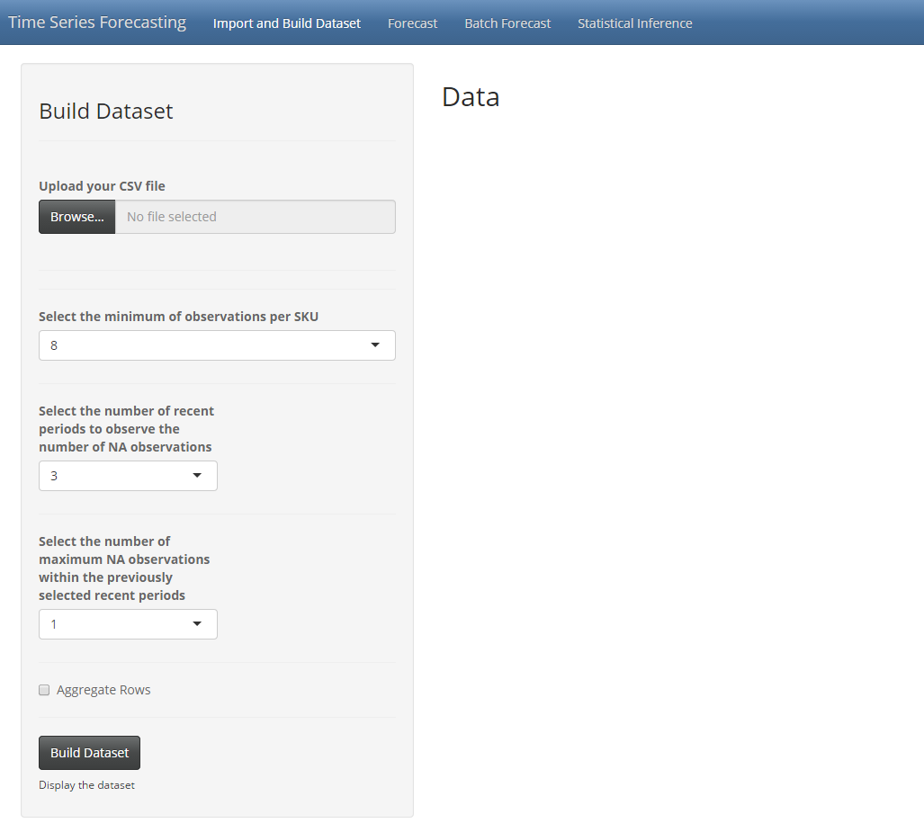
Web Application Homepage
Launching the application will open the application’s homepage. The homepage is the starting point for uploading, filtering and building your demand dataset.
The following are tabs to switch between different pages of the application.
To upload data, click on Browse… to open a directory window to browse and select a csv file to upload. There is a max file size of 30mb.

Slide 4
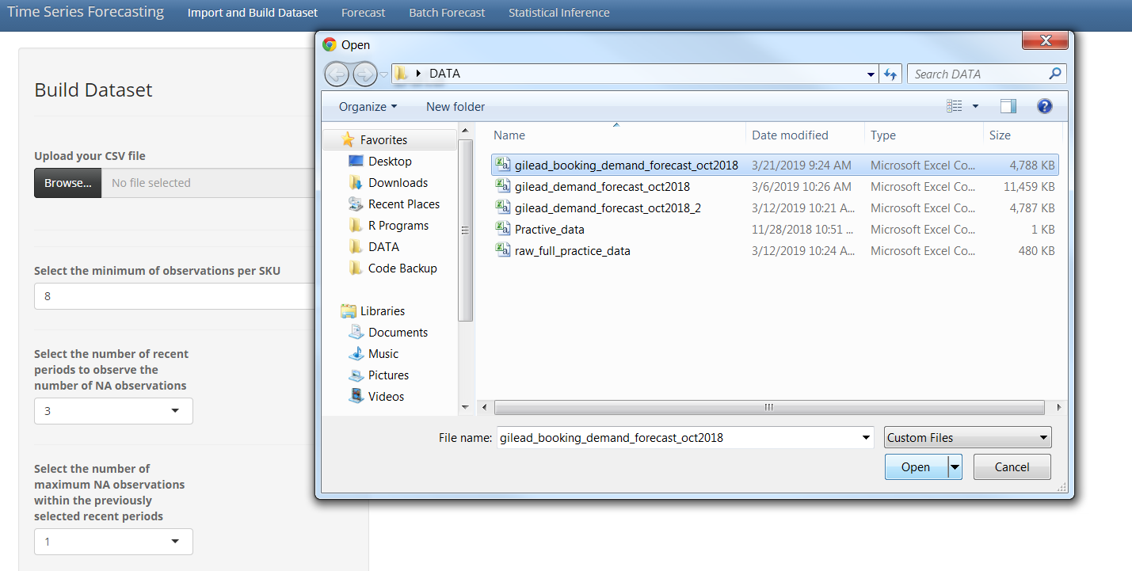
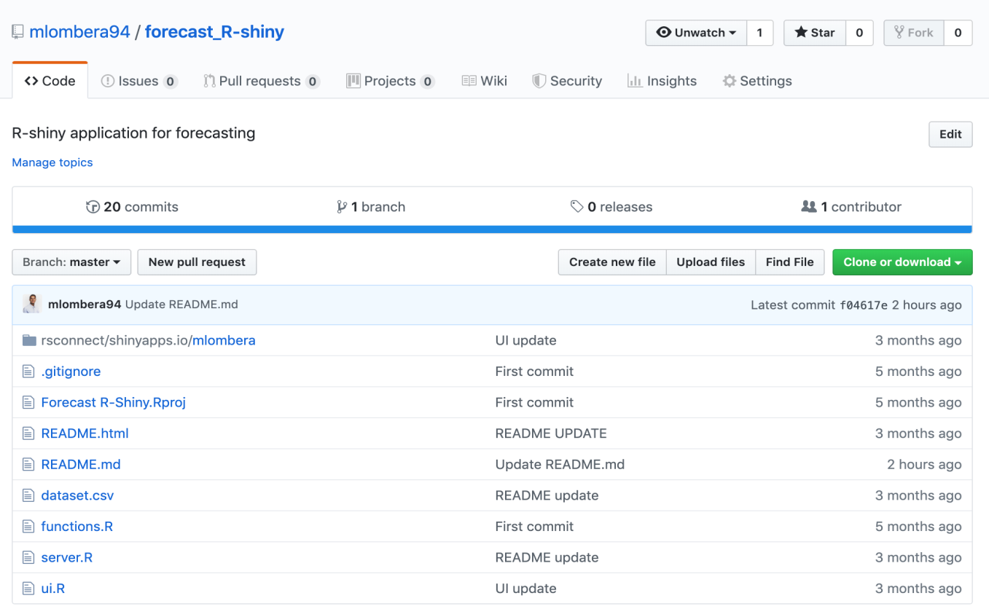
Downloading the Example Dataset
A sample dataset can be downloaded from the forecast_R-shiny github page to get started. The data has already been structured properly for this application. Click on Browse… once the csv file has been downloaded to select the file to upload and hit enter.

Slide 5
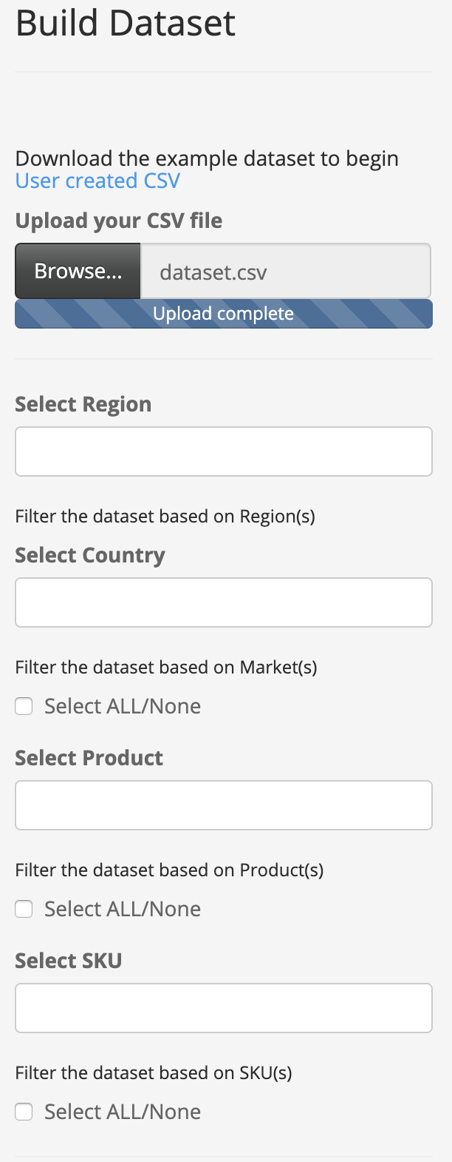
Filtering and Building your Dataset
Once the file has been uploaded, the file name will display in the text box.
User can select which regions to include in the dataset.
Select ALL/None allows the user to quickly select all available Countries in the Regions specified prior.
The following input boxes allow the user to filter the dataset by Region, Country, Product, and SKU by specifying each criterion.
Select ALL/None allows the user to quickly select all available Products in the Countries specified prior.
Select ALL/None allows the user to quickly select all available SKUs in the Products specified prior.
Notes:
UPDATE!!!!!!!!!!!!!

Slide 6
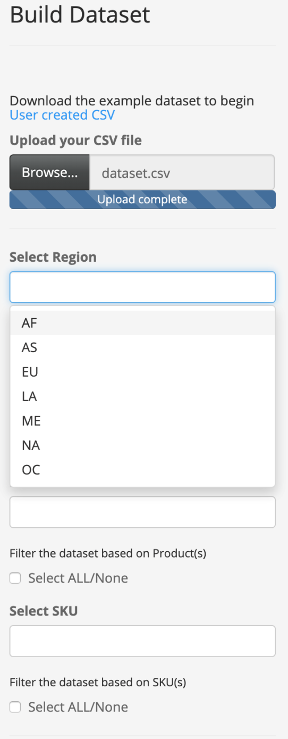
Selecting Region(s)
The first filter provided to the user is Regions. When clicked, a drop down menu appears displaying the Regions in the dataset. The user may also type in the text box to select the Region. More than one Region may be specified.
Notes:
UPDATE!!!!!!!!!!!!!

Slide 7
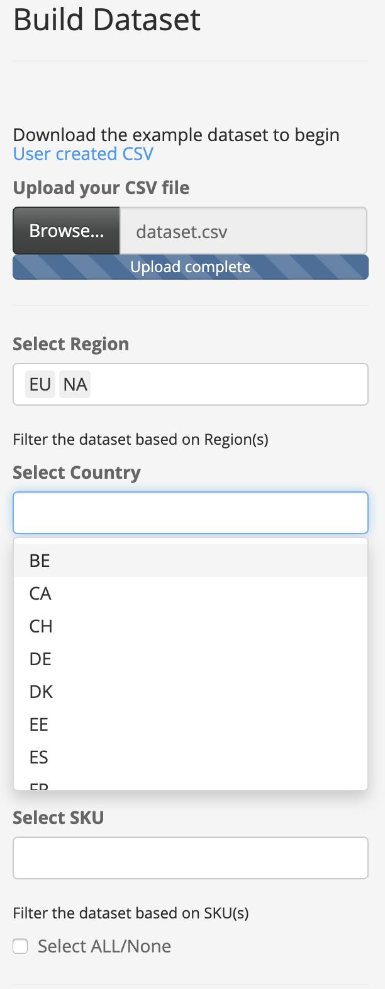
Selecting Market(s)
The second filter provided to the user is Country. When clicked, a drop down menu appears displaying the Country in the Regions selected in the previous filter. The user may also type in the text box to select the Country. More than one Country may be specified.
Notes:
UPDATE!!!!!!!!!!!!!

Slide 8
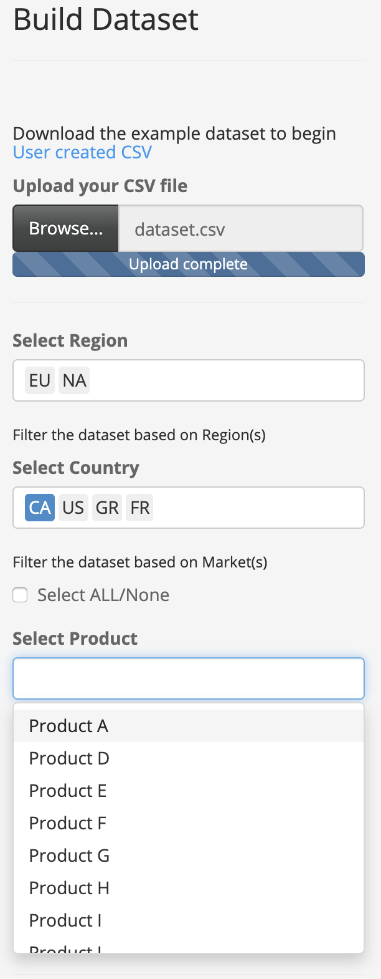
Selecting Product(s)
The third filter provided to the user is Products. When clicked, a drop down menu appears displaying the Products in the Countries selected in the previous filter. The user may also type in the text box to select the Product(s). More than one Product may be specified.

Slide 9
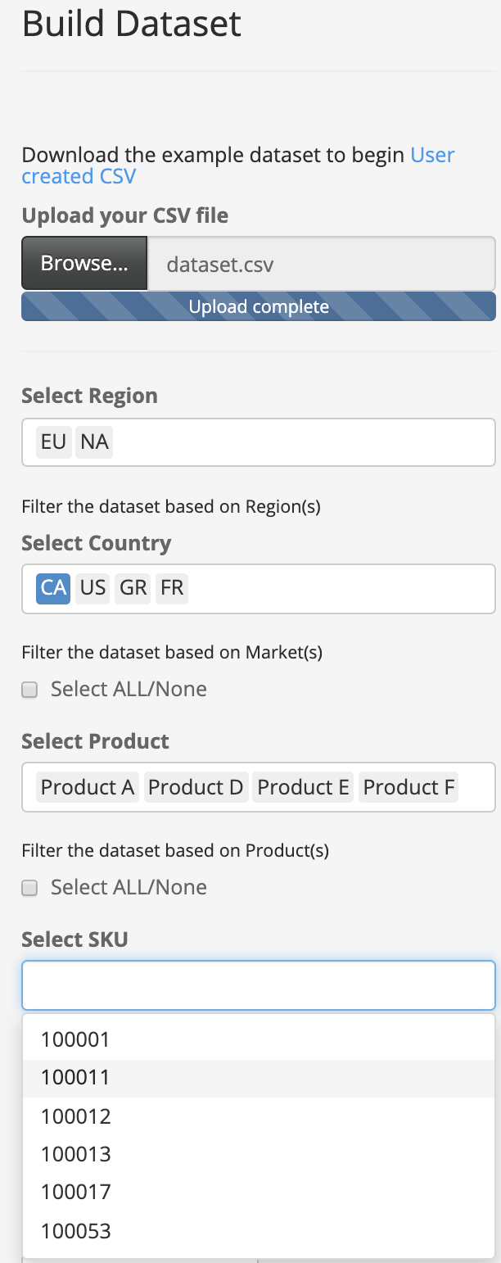
Selecting SKU(s) & Building theDataset
The final filter provided to the user is SKUs. When clicked, a drop down menu appears displaying the SKUs of the Products selected in the previous filter. The user may also type in the text box to select the SKU(s). More than one Product may be specified.
Notes:
UPDATE!!!!!!!!!!!!!

Slide 10
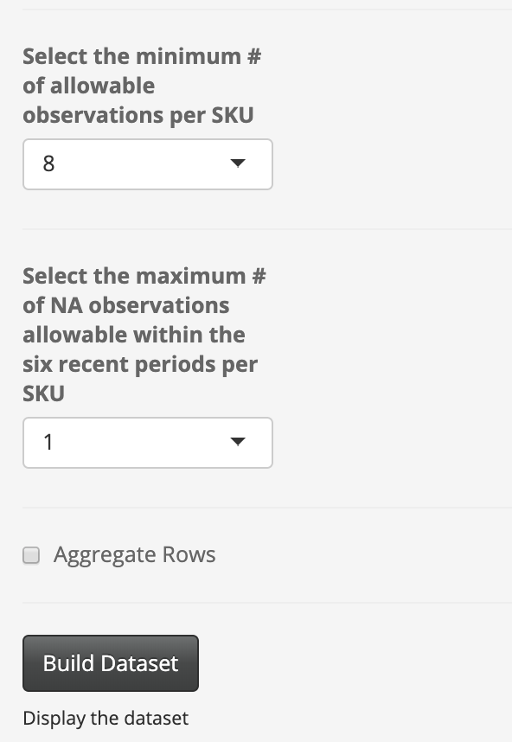
Selecting SKU(s) & Building the Dataset
Allows the user to filter out SKUs that don’t meet the selected minimum number of non-NA observations.
Allows the user to specify the maximum number of NA observations within the six most recent observations for each SKU. If the SKU contains more than the specified number of NA observations within the six most recent periods, they are filtered out of the final dataset.
Aggregate Rows allows the user to create a column in the dataset that aggregates the rows of Booking Actuals selected from the dataset. Note that more than one SKU must have been selected from the dataset for this option to be applied.
Once the user has selected the Region(s), Market(s), Product(s), and SKU(s) to include in their dataset, the user must click Build Dataset to create and display the dataset.
Notes:
UPDATE!!!!!!!!!!!!!

Slide 11
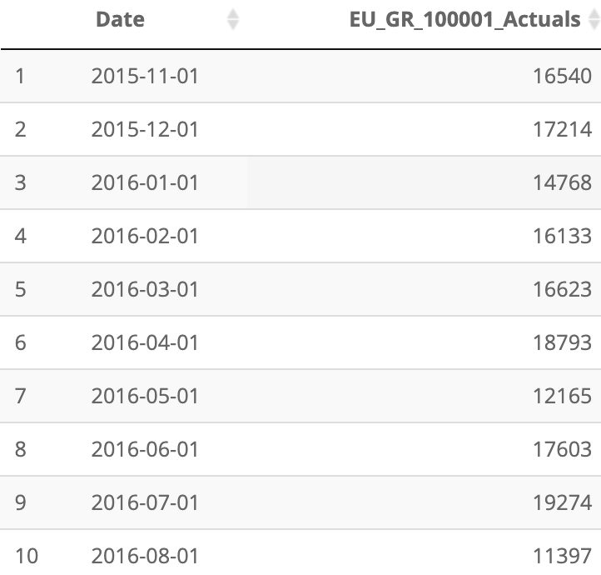
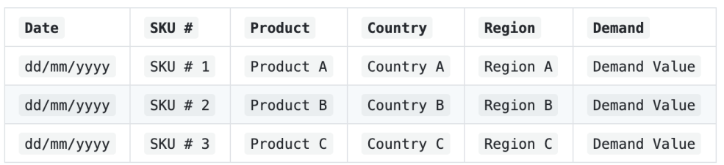
Raw Data to Built Dataset Conversion
Region
Country
SKU #
Backend conversion of Raw Data
Based on the selected filters applied to the raw data, the application will gather Region, Country, and SKU into a single column in order for each SKU to have its own column of shipment actuals. If SKUs don’t begin at the same date, empty rows of missing data will be replaced with NAs. If there is no observation for a SKU for a specific data(s), NAs will be inserted.

Slide 12
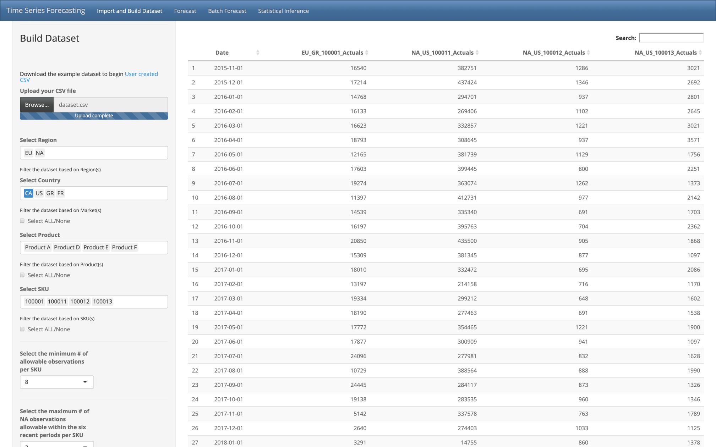
Displaying the Dataset
Allows the user to search for specific row observations based on Shipment Actuals or Date
Date Column on a Monthly Basis
Each column represents the Demand for each SKU.

Slide 13
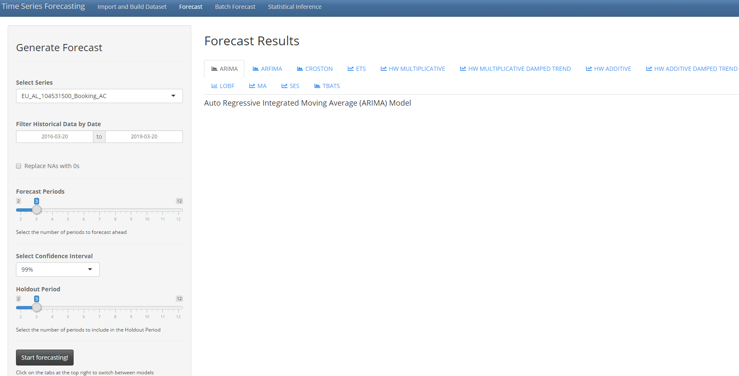
Applying Statistical Forecasts on Demand Data
Select the SKU using the drop down menu to apply Statistical Forecasts on
The following are tabs to select the specified statistical model and its plotted forecast. The graph is displayed once Start Forecasting! is clicked.
Specify the date range of observations to include in the statistical forecasts. Note, Start is automatically set to three years prior to the current date and End is automatically set to the current date.
When selected, replaces NA Booking Actual observations with 0
Select the number of monthly periods to forecast ahead
Select the confidence interval to forecast. Note, the lower the confidence interval, the smaller the upper and lower bounds become
Select the number of monthly periods to use as a Holdout Period to measure model performance
Click on Start Forecasting! to begin the forecast
Notes:
UPDATE!!!!!!!!!!!!!

Slide 14
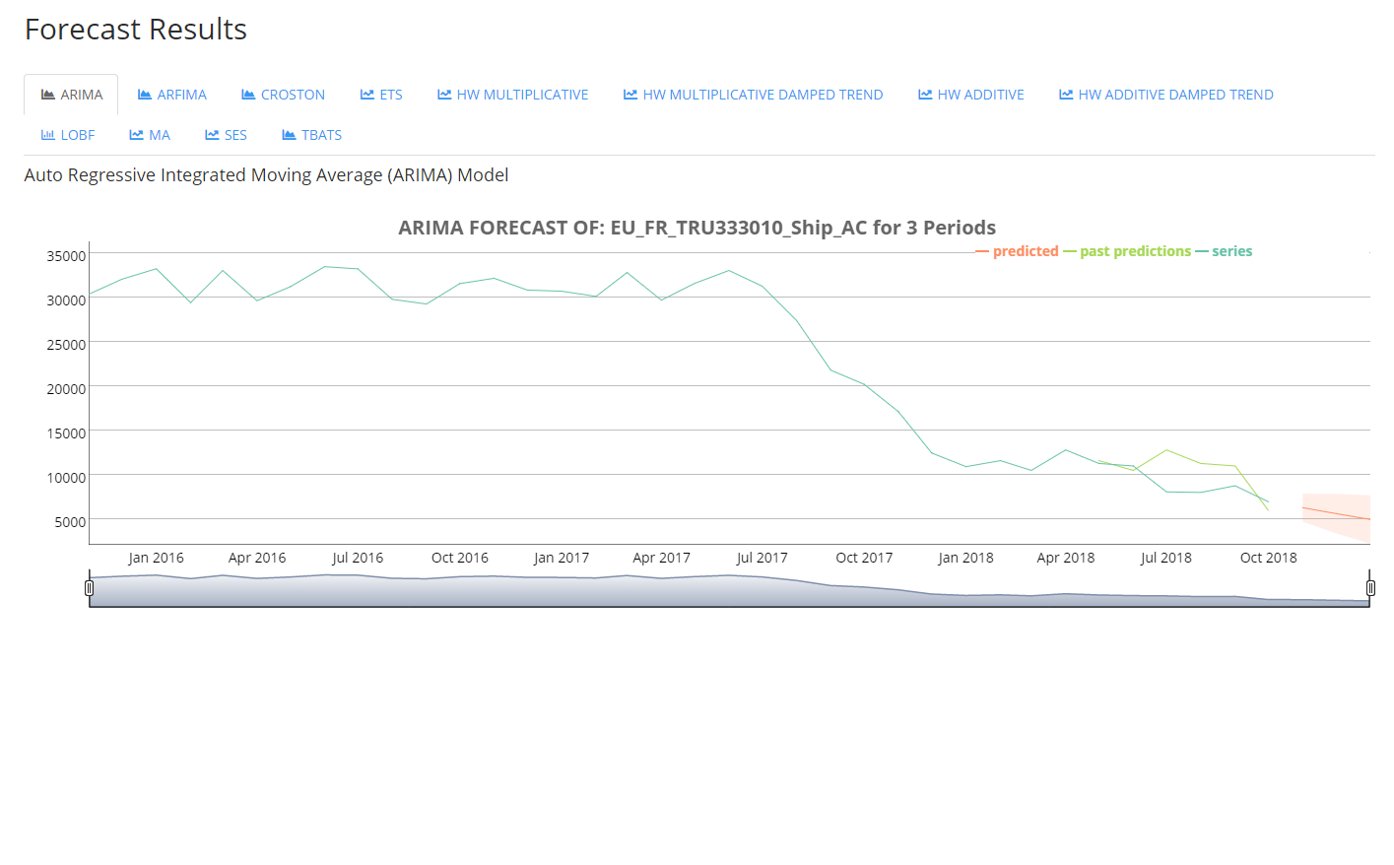
Navigating Forecast Results
The light green line represents the forecasts of the Holdout Period
The teal line represents the Booking Actuals
The orange line represents the current forecast. The shaded region includes the upper and lower bounds of the forecast using the specified confidence interval

Slide 15
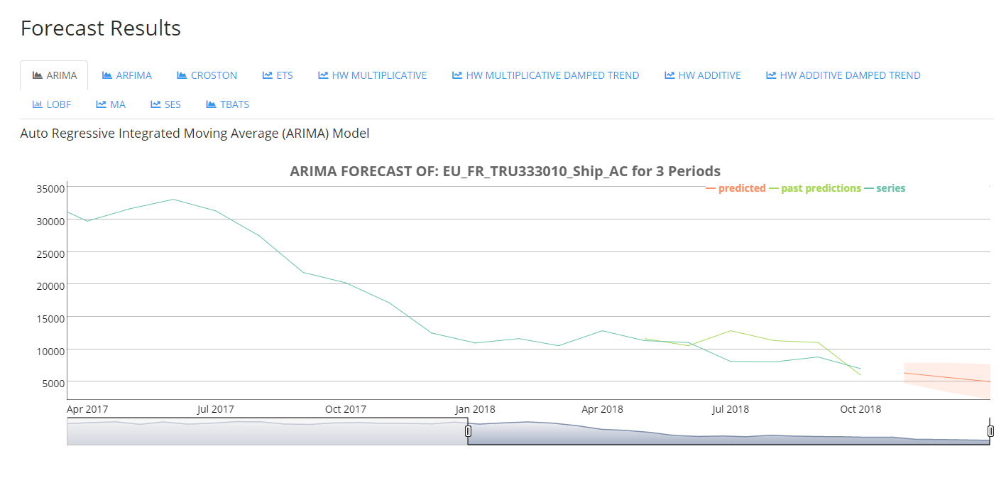
Navigating Statistical Forecast Graph
The user may narrow and zoom in to a particular region of the graph by dragging the endpoints to the specified date range.
Note, the user may double click on the graph itself to reset and zoom back to the original settings of the graph.

Slide 16
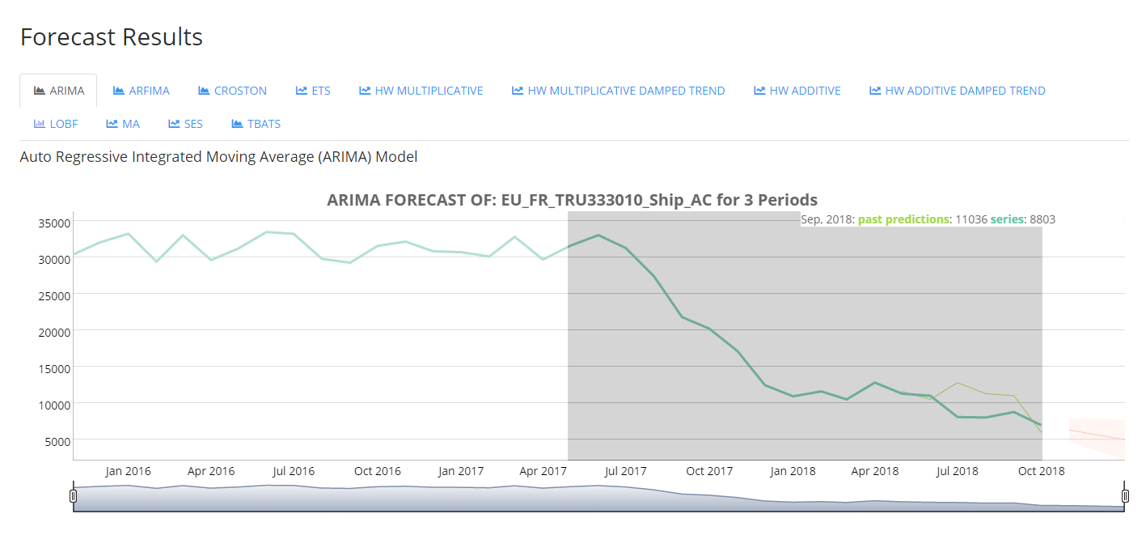
Navigating Statistical Forecast Graph
The user may also narrow and zoom in to a particular region of the graph by highlighting the specified region of the graph. Note, the user may double click on the graph itself to reset and zoom back to the original settings of the graph.

Slide 17
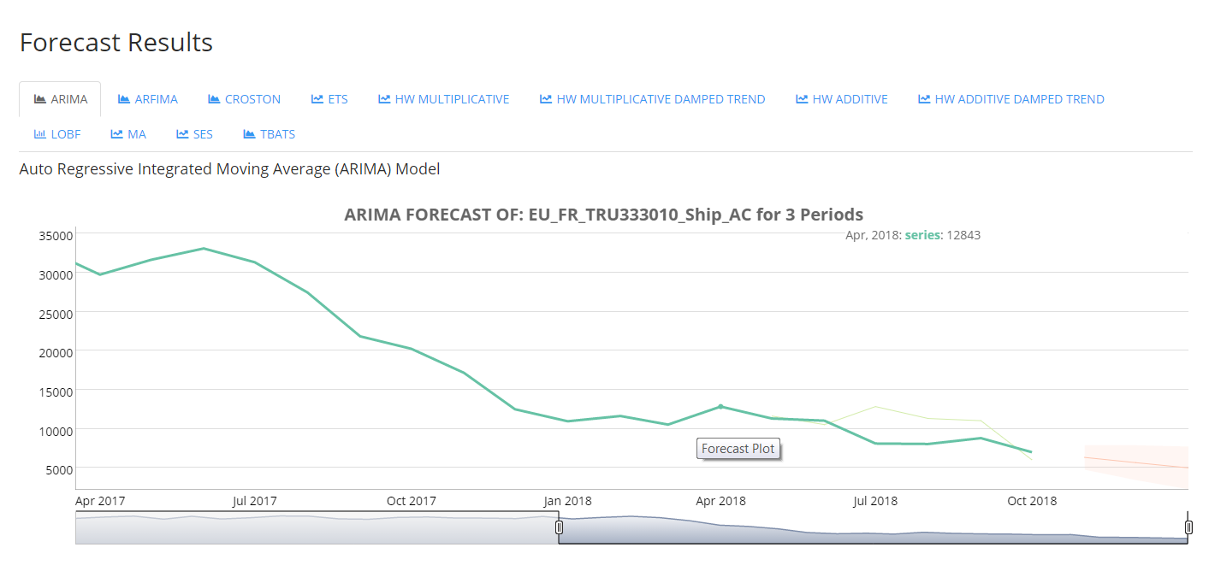
Navigating Statistical Forecast Graph
The user has the ability to hover over and emphasize the plotted series to view the specific Shipment Actual for the specified month being hovered over.

Slide 18
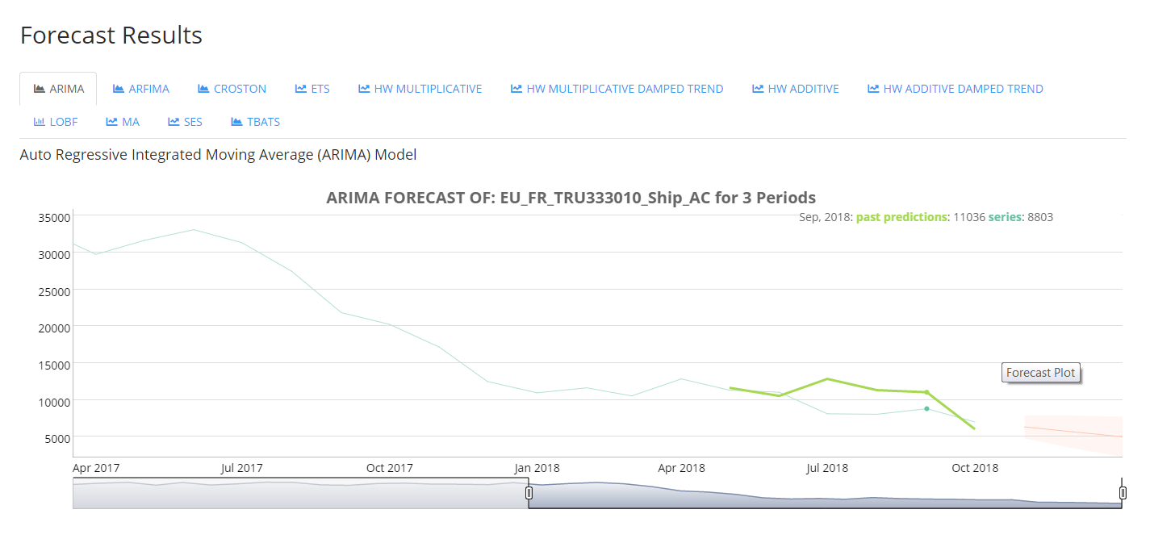
Navigating Statistical Forecast Graph
The user has the ability to hover over and emphasize the plotted series to view the specific Holdout Period Forecast for the specified month being hovered over.

Slide 19
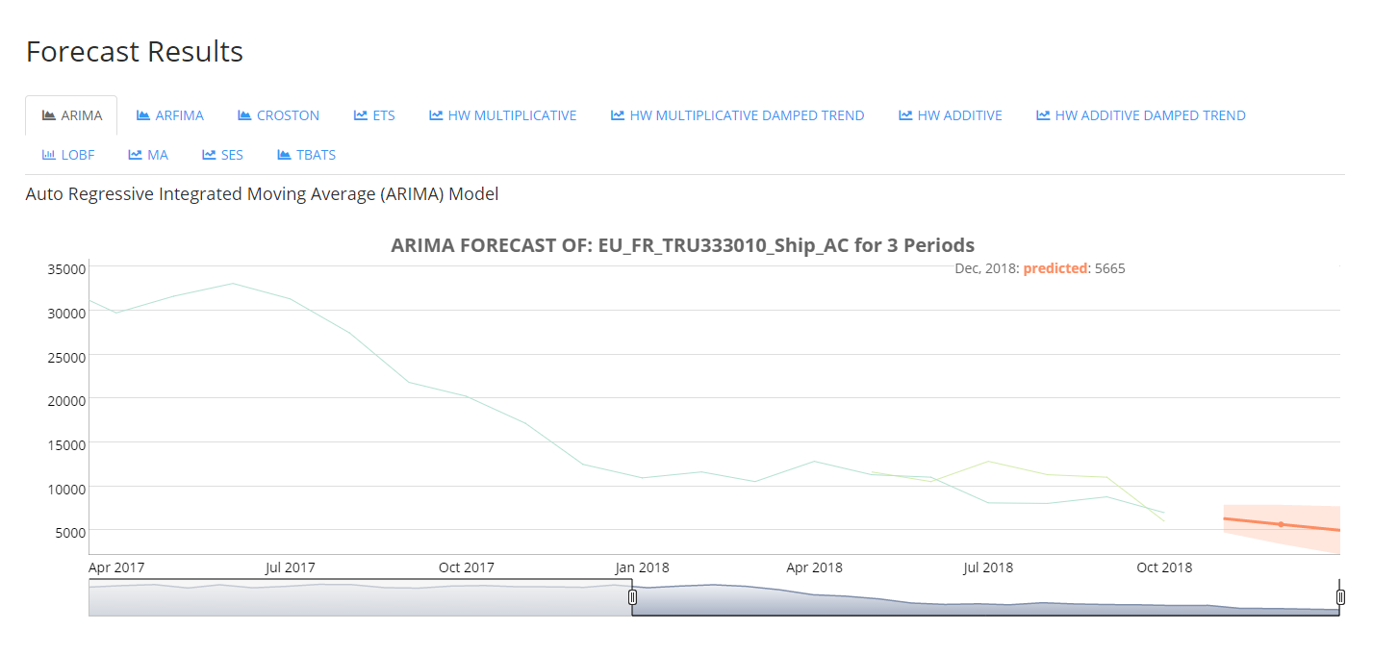
Navigating Statistical Forecast Graph
The user has the ability to hover over and emphasize the plotted series to view the specific Statistical Model Forecast for the specified month being hovered over. Note, upper and lower bounds are not shown in the legend.

Slide 20
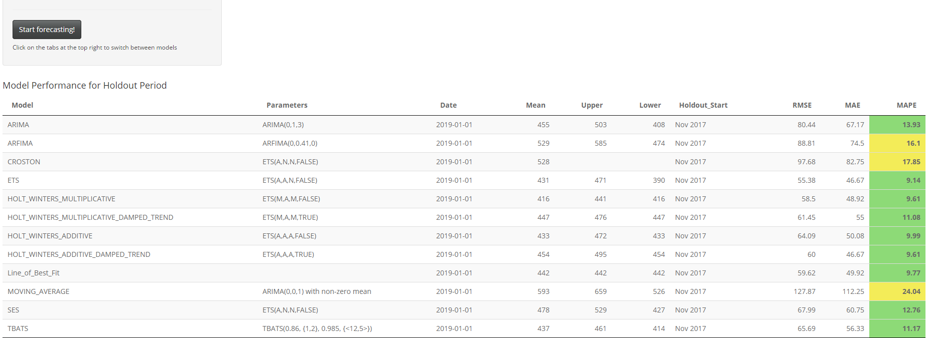
Navigating Model Performance Table
Scrolling down, the Model Performance Table can be viewed to display important information such as the predicted forecasts as well as the error measurements from the Holdout Period of each model.
The MAPE column has a color code to distinguish between different levels of MAPE measurements. Green indicates a MAPE of 0%-15%, Yellow indicates a MAPE of 15.01%-45% while Red indicates a MAPE higher than 45%.
The Model column specifies what model was used in the statistical forecast
The Parameters column specifies the parameters used in the Model. There are three types of Parameters: ARIMA/ARFIMA, ETS, and TBATS/BATS
The Date column shows the date forecasted
The Mean column specifies the predicted forecast
The Upper column shows the upper bound of the predicted forecast
The Lower column shows the lower bound of the predicted forecast
The Holdout-Start column indicates the first month of the testing period
The RMSE column shows the calculated
RMSE of the Holdout Period forecast
The MAE column shows the calculated
MAE of the Holdout Period forecast
The MAPE column shows the calculated MAPE of the Holdout Period forecast

Slide 21
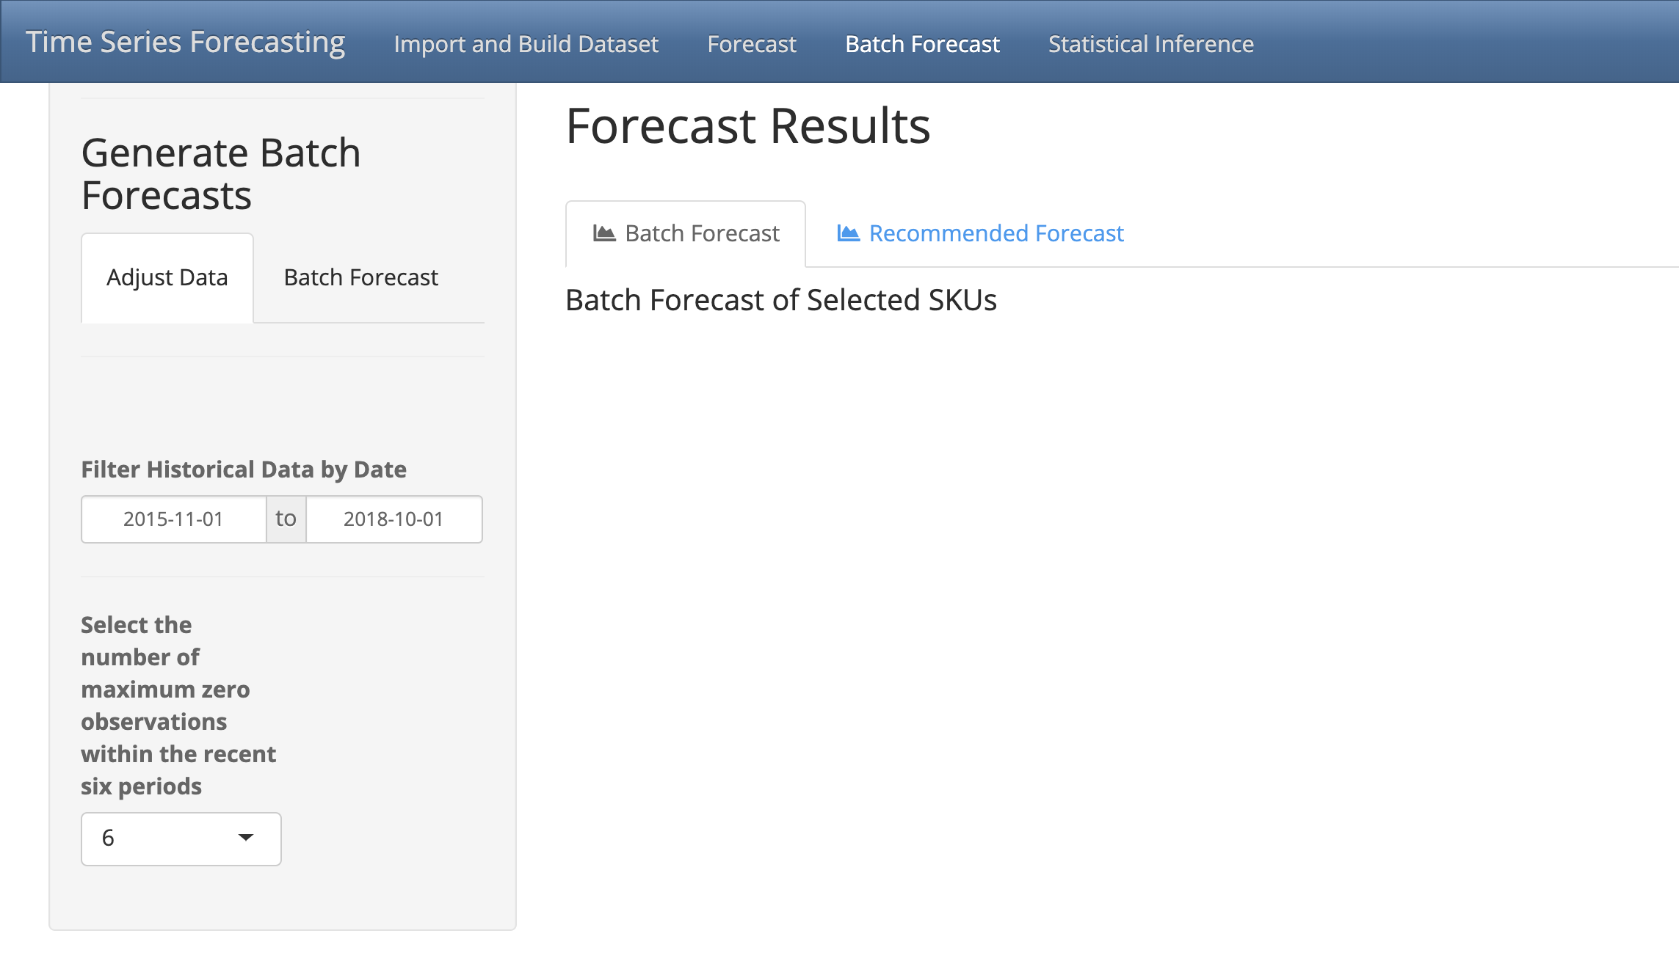
Navigating Batch Statistical Forecasts
Tabs to switch between viewing all statistical models applied to the SKUs in the dataset vs only displaying the best performing model for each SKU in the dataset
Tabs to switch between adjusting the data and creating statistical forecasts
Specify the date range of observations to include in the statistical forecasts. Note, Start is automatically set to three years prior to the current date and End is automatically set to the current date
The user can specify the maximum number of zero observation within the last six periods. If a SKU contains more than the specified number of zero observations, then it is removed from the dataset and no statistical forecast is applied to that SKU.

Slide 22
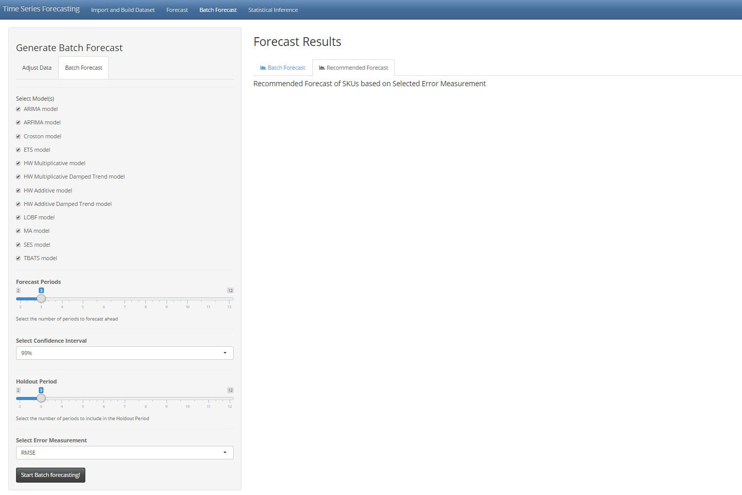
Navigating Batch Statistical Forecasts
Tabs to switch between viewing all statistical models applied to the SKUs in the dataset vs only displaying the best performing model for each SKU in the dataset
Tabs to switch between adjusting the data and creating statistical forecasts
Select the models to be applied to the dataset. All models may be applied at once
Select the number of monthly periods to forecast ahead.
Select the confidence interval to forecast. Note, the lower the confidence interval, the smaller the upper and lower bounds become
Select the number of monthly periods to use as a Holdout Period to measure model performance
Select the error measurement to use to determine the best statistical model
Click on Start Forecasting! to begin the forecast

Slide 23
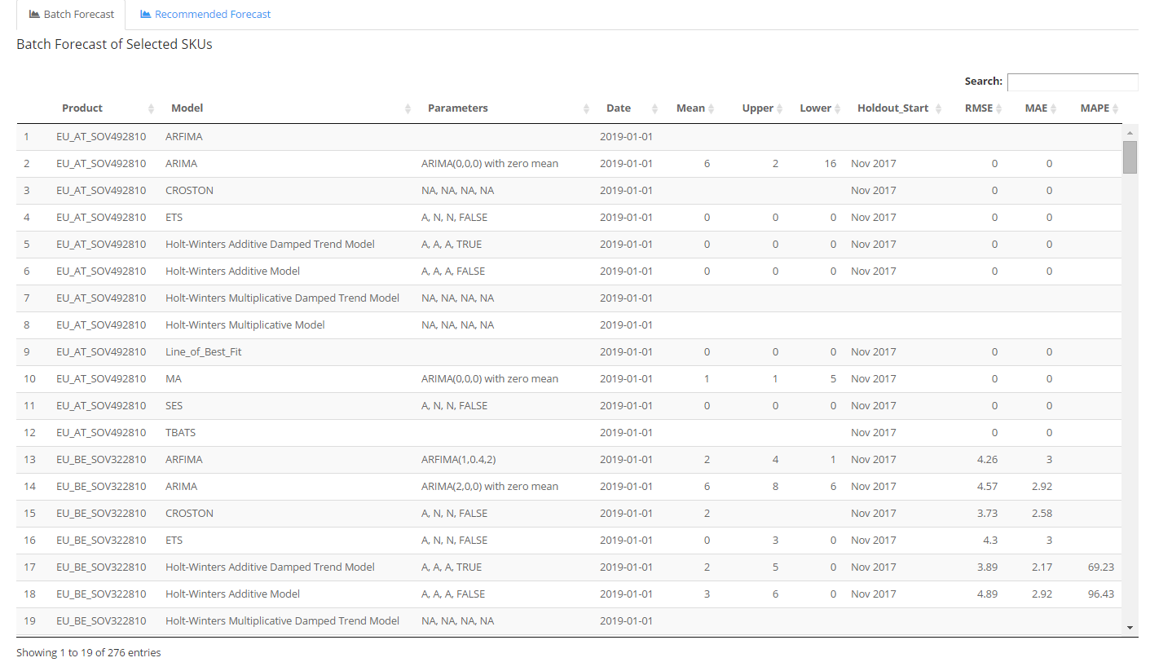
Navigating Batch Statistical Forecast Table
Once the forecasts have been generated, all the applicable and selected models are applied to each SKU in the dataset. They are then displayed in the Batch Forecast table.
The Product column specifies the SKU
The Model column specifies what model was used in the statistical forecast
The Parameters column specifies the parameters used in the Model. There are three types of Parameters: ARIMA/ARFIMA, ETS, and TBATS/BATS
The Date column shows the date forecasted
The Mean column specifies the predicted forecast
The Upper column shows the upper bound of the predicted forecast
The Lower column shows the lower bound of the predicted forecast
The Holdout-Start column indicates the first month of the testing period.
The RMSE column shows the calculated
RMSE of the Holdout Period forecast
The MAE column shows the calculated
MAE of the Holdout Period forecast
The MAPE column shows the calculated MAPE of the Holdout Period forecast

Slide 24
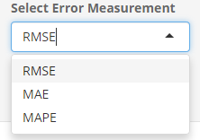
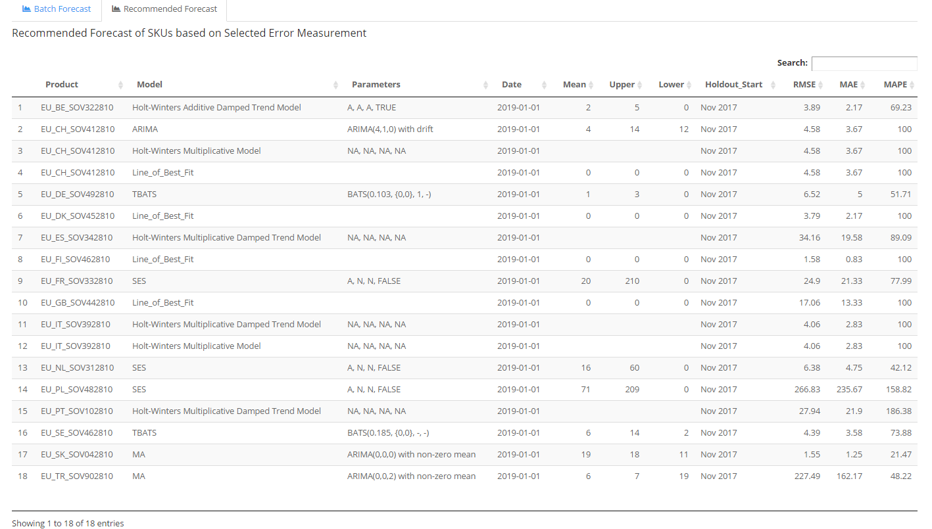
Navigating Recommended Batch Statistical Forecasts
The user can switch to the Recommended Forecast tab to view only the best performing model for each SKU based on the error measurement selected earlier as opposed to viewing all the models applied for each SKU in the Batch Forecast tab

Slide 25
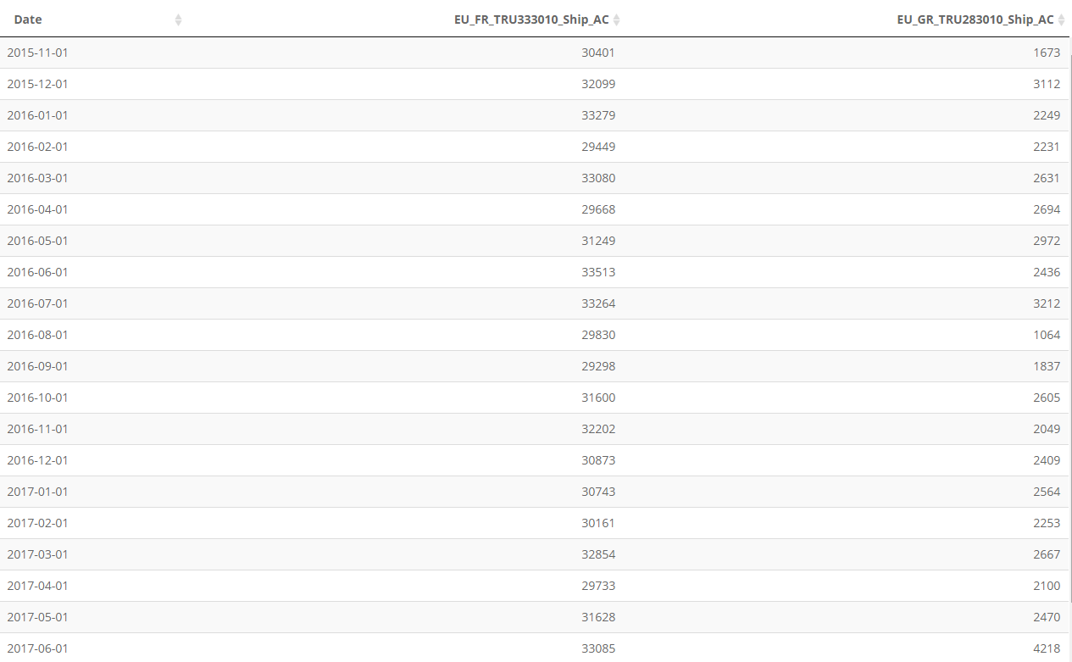
Backend Process of Forecasting
The Backend process for forecasting consists of the user selecting a single SKU from the dataset built previously. All 12 statistical models will be applied if the dataset meets each models requirements.

Slide 26
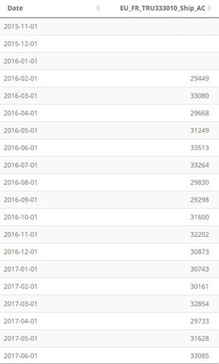
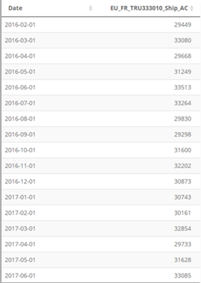
Backend Process of Forecasting
Once a SKU has been selected, a for-loop will run to subset the dataset to remove any initial NA observations. This allows the dataset to remove any unnecessary NA observations prior to the first numerical observation in order to have the correct start date. *NOTE, this will not remove any subsequent NA observations proceeding the start date. If the user enables the option to replace NA values with 0 observations, this will only be applied to NA values proceeding the updated start date and not those prior to the first numerical observation.

Slide 27
Backend Process of Forecasting
The dataset will then go through a verification process for each statistical model to determine if the model can be applied to the dataset. This involves checking the number of total observations, the total number of 0 observations, and whether or not the dataset contains NA observations. Once a model has been verified to be applied, a forecast will be created with the user specifications i.e. how many periods ahead to forecast and the confidence interval to forecast.

Slide 28
Backend Process of Forecasting
In order to compare the performance of each applicable statistical model for a given SKU, a holdout period is defined by the user. This can range from either the previous 2 months up until the previous year. This holdout period subsets the data to create “prior” forecasts

Slide 29
Statistical Model Requirements
ARIMA – The ARIMA model has no requirements in order to be applied to the dataset
ARFIMA - The ARFIMA model requires there to be a minimum of 5 observations in the dataset. The data may not contain NA observations either.
CROSTON – The data may not contain NA observations. If there are less than two non-zero observations in the dataset, no parameters will be extracted from the model used to forecast. *Note, the Croston model does not take confidence interval parameters so there is no upper/lower bound to its forecast.
ETS – The ETS model has no requirements in order to be applied to the dataset.
HOLT-WINTERS MULTIPLICATIVE – The Holt-Winters multiplicative model requires the dataset to not include any 0 observation. It also requires the dataset to have a minimum of 15 observations
HOLT-WINTERS MULTIPLICATIVE W/ DAMPED TREND– The Holt-Winters multiplicative w/ damped trend model requires the dataset to not include any 0 observation. It also requires the dataset to have a minimum of 15 observations
HOLT-WINTERS ADDITIVE – The Holt-Winters additive model requires the dataset to have a minimum of 15 observations.
HOLT-WINTERS ADDITIVE W/ DAMPED TREND – The Holt-Winters additive model requires the dataset to have a minimum of 15 observations.
LINE OF BEST FIT – The line of best fit has no requirements in order to be applied to the dataset.
MOVING AVERAGE – The moving average model has no requirements in order to be applied to the dataset.
SIMPLE EXPONENTIAL SMOOTHING – The simple exponential smoothing model (SES) has no requirements in order to be applied to the dataset.
TBATS – The TBATS model requires the dataset to not contain any NA observations.

Slide 30
Known Bugs in Application
Import and Build Dataset
Premature Dataset Build - If the BUILD DATASET button is clicked before all fields have been filled, the app will crash and will require the user to relaunch the application from R-Studio.
Solution: Make sure all fields are filled out prior to clicking on the BUILD DATASET button.
Empty Dataset Build – If all fields have been filled out and no SKU meets the users requirements, after clicking BUILD DATASET the app will crash, requiring the user to relaunch the application from R-Studio.
Solution: If the dataset does not meet the requirements, choose another SKU. The minimum requirements set are in place to eliminate datasets that contain a majority of missing or 0 observations and to avoid errors when running the statistical models.
Batch Forecast
Single Dataset – If the dataset contains only one SKU or the user requirements filter out all SKUs or only leave one SKU left, then after clicking START BATCH FORECASTING will result in a bug which results in no output and an error message.
Statistical Inference
ACF/Decomposition Plots - ACF plots and Decomposition plots will not work if NAs are present in the data.
Solution: User must replace NA values with zero values using the replace NAs options prior to constructing ACF and Decomposition plots
Notes:
- Cannot click on build dataset unless all previous fields have been filled out (APP will Crash)
No forecast will be shown in batch forecast if there is only one or no sku in the dataset, must have min two SKUs in dataset for batch forecast to work (Error will display)
If no SKU meets the dataset filter requirements when building the dataset, app will crash

